Slide 1
WINDOWS
UNIT III

Slide 2
WINDOW CHARACTERISTICS:
A window is seen to possess the following characteristics:
A name or title, allowing it to be identified.
A size, height and width which can vary.
A state, accessible or active or not accessible. (Only active windows can have their contents altered.)
Visibility, the portion that can be seen. (A window may be partially or fully hidden behind another window or the information within a window may extend beyond the window’s display area.)
Presentation, that is, its arrangement in relation to other windows. It may be tiled, overlapping, or cascading.
Its highlight, that is, the part that is selected.

Slide 3
1. Attraction of Windows:
Windows seems to be useful in the following ways.
Presentation of Different Levels of Information.
Table of content in one window simultaneously more detail in adjoining window.
Presentation of Multiple Kinds of Information.
Variable information needed to complete a task can be displayed simultaneously in adjacent windows.
Sequential Presentation of Levels or Kinds of Information.
Steps to accomplish a task can be sequentially presented through windows.
Key windows may remain displayed, but others appear and disappear as necessary.

Slide 4
Access to Different Sources of Information.
Independent sources of information may be accessed at the same time.
Combining Multiple Sources of Information.
Text from several documents may be reviewed and combined into one.
Performing More Than One Task.
While waiting for a long, complex procedure to finish, another can be performed.
Tasks of higher priority can interrupt less important ones and then the interrupted tasks can be preceded.
Reminding.
It can be used to provide remainder through messages or popup or menus.
Multiple Representations of the Same Task.
The same task can be represented in two different ways in two windows.

Slide 5
2. Constraints in Window System Design:
Historically, system developers have been much more interested in solving hardware problems than in user considerations.
This lack of guidelines makes it difficult to develop acceptable and agreeable window standards.
The result is that developers of new systems create another new variation each time they design a product, and users must cope with a new interface each time they encounter a new windowing system.

Slide 6
COMPONENTS OF A WINDOW:
1. Frame:
A window will have a frame or border to define its boundaries and distinguish it from other windows.
Usually rectangular in shape but need not be rectangular.
2. Title Bar:
The title bar is the top edge of the window, inside its border and extending its entire width.

Slide 7
Also referred as the caption, caption bar, or title area by some platforms.
The title bar contains a descriptive title identifying the purpose or content of the window.
3. Title bar Icon
Located at the left corner of the title bar in a primary window, this button is used in Windows to retrieve a pull-down menu of commands that apply to the object in the window.

Slide 8
4. Window Sizing Buttons:
Located at the right corner of the title bar, these buttons are used to manipulate the size of a window.
The leftmost button, the minimize button— inscribed with a short horizontal line toward the bottom of the button—is used to reduce a window to its minimum size, usually an icon.
The maximize button—typically inscribed with a large box—enlarges a window to its maximum size, usually the entire screen. When a screen is maximized, the restore button replaces the maximize button, since the window can no longer be increased in size.

Slide 9
Guidelines:
When a window does not support a command, do not display its command button.
The Close button always appears as the rightmost button. Leave a gap between it and any other buttons.
The Minimize button always precedes the Maximize button.
The Restore button always replaces the Maximize button or the Minimize button when that command is carried out.

Slide 10
5. What’s This? Button:
The What’s This? Button, which appears on secondary windows and dialog boxes, is used to invoke the What’s This?
Windows command to provide contextual Help about objects displayed within a secondary window.
6. Menu Bar:
A menu bar is used to organize and provide access to actions. It is located horizontally at the top of the window, just below the title bar.
A menu bar contains a list of topics or items that, when selected, are displayed on a pull-down menu beneath the choice.

Slide 11
7. Status Bar
Information of use to the user can be displayed in a designated screen area or areas. They may be located at the top of the screen in some platforms and called a status area, or at the screen’s bottom.
Microsoft recommends the bottom location and refers to this area as the status bar. It is also referred to by other platforms as a message area or message bar.
8. Scroll Bars
When all display information cannot be presented in a window, the additional information must be found and made visible.

Slide 12
This is accomplished by scrolling the display’s contents through use of a scroll bar.
A scroll bar is an elongated rectangular container consisting of a scroll area or shaft, a slider box or elevator, and arrows or anchors at each end.
For vertical scrolling, the scroll bar is positioned at the far right side of the work.
9. Split Box
A window can be split into two or more pieces or panes by manipulating a split box located above a vertical scroll bar or to the left of a horizontal scroll bar.
A split box is sometimes referred to as a split bar.
A window can be split into two or more separate viewing areas that are called panes.

Slide 13
10. Toolbar
Toolbars are permanently displayed panels or arrays of choices or commands that must be accessed quickly. They are sometimes called command bars.
Toolbars are designed to provide quick access to specific commands or options. Specialized toolbars are sometimes referred to as ribbons, toolboxes, rulers, or palettes.
11. Command Area
In situations where it is useful for a command to be typed into a screen, a command area can be provided.
The desired location of the command area is at the bottom of the window.

Slide 14
12. Size Grip
A size grip is a Microsoft Windows special handle included in a window to permit it to be resized.
When the grip is dragged the window resizes, following the same conventions as the sizing border. Three angled parallel lines in the lower-right corner of a window designate the size grip.
13. Work Area
The work area is the portion of the screen where the user performs tasks.
It is the open area inside the window’s border and contains relevant peripheral screen components such as the menu bar, scroll bars, or message bars.
The work area may also be referred to as the client area.

Slide 15
WINDOW PRESENTATION STYLES:
The presentation style of a window refers to its spatial relationship to other windows.
There are two basic styles, commonly called tiled or overlapping.
1. Tiled Windows:
Tiled windows derive their name from common floor or wall tile.
Tiled windows appear in one plane on the screen and expand or contract to fill up the display surface, as needed.
Most systems provide two-dimensional tiled windows, adjustable in both height and width.

Slide 16
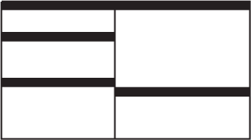
Advantages:
System allocates and positions windows for the user.
Every window is always completely visible.
Eliminating the possibility of them being lost and forgotten.
Perceived as fewer complexes than overlapping windows.
Easier for novice or inexperienced people to learn and use.

Slide 17
Disadvantages:
Limited number can be displayed in the screen area available.
As windows are opened or closed, existing windows change in size. This can be annoying.
As number of displayed windows increases, each window can get very tiny.
Difficult to predict because of change in size and location.
Configuartion by system may not meet the user needs.
Perceived as crowded and more visually complex.
Permit less user control.

Slide 18

2. Overlapping Windows:
Overlapping windows may be placed on top of one another like papers on a desk.
They possess a three-dimensional quality, appearing to lie on different planes.

Slide 19
Advantages:
Visually, their look is three-dimensional.
Greater control allows the user to organize the windows to meet his or her needs.
Larger size and Consistent position.
Screen space conservation is not a problem.
Less visual crowding and complexity.
Disadvantages:
Operationally much more complex than tiled windows.
Information in windows can be hidden behind other windows.

Slide 20

3. Cascading Windows:
A special type of overlapping window has the windows automatically arranged in a regular progression.
Each window is slightly offset from others, as illustrated in Figure.
Advantages:
No window is ever completely hidden.
Bringing any window to the front is easier.
It provides simplicity in visual presentation and cleanness.

Slide 21
Picking a Presentation Style:
Use tiled windows for:
Single-task activities.
Data that needs to be seen simultaneously.
Tasks requiring little window manipulation.
Novice or inexperienced users.
Use overlapping windows for:
Switching between tasks.
Tasks necessitating a greater amount of window manipulation.
Expert or experienced users.
Unpredictable display contents.

Slide 22
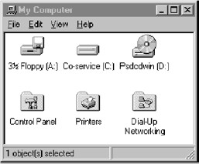
TYPES OF WINDOWS:
1. Primary Window:

Slide 23
1.1 Proper Usage:
Should represent an independent function or application.
Use to present constantly used window components and controls.
Used frequently.
Used for presenting information that is continually updated.
Use for providing context for dependent windows to be created.
1.2 Guidelines:
Do not divide an independent function into two or more primary windows.
Do not present unrelated functions in one primary window.
Also referred to as the application window or the main window or the parent window.

Slide 24
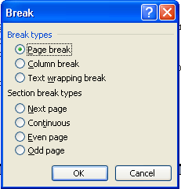
2. Secondary Windows:
2.1 Proper Usage:
For performing subordinate, supplemental, or ancillary actions that are:
Extended or more complex in nature.
Related to objects in the primary window.
For presenting frequently or occasionally used window components.

Slide 25
2.2 Guidelines:
Should typically not appear as an entry on the taskbar.
A secondary window should not be larger than 263 dialog units x 263 dialog units.
A dependent secondary window can only be displayed from a command on the interface of its primary window. Typically associated with a single data object, and appears on top of the active window when requested. It is movable, and scrollable.
An independent secondary window can be opened independently of a primary window—for example, a property sheet displayed when the user clicks the Properties command on the menu of a desktop icon.

Slide 26
a. Modal and Modeless:
Modal:
Use when interaction with any other window must not be permitted.
Use for:
Presenting information (message box).
Receiving user input (prompt box).
Asking questions (question box).
Modeless:
Use when interaction with other windows must be permitted.
Use when interaction with other windows must be repeated.

Slide 27
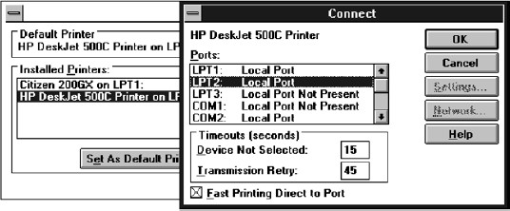
b.Cascading and Unfolding:
Cascading:
Purpose:
To provide advanced options at a lower level in a complex dialog.
Guidelines:
Provide a “To a Window” indicator an ellipsis (. . . ).
Present the additional dialog box in cascaded form.
Provide no more than two cascades in a given path.

Slide 28
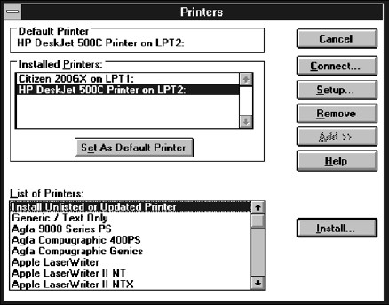
Unfolding:
Purpose:
To provide advanced options at the same level in a complex dialog.
Guidelines:
Provide an expanding dialog symbol (>>).
Expand to right or downward.

Slide 29
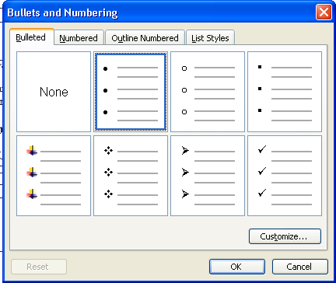
c. Property Sheets and Property Inspectors:
Secondary windows provide two other techniques for displaying properties, property sheets and property inspectors.
Property Sheets:

Slide 30
Use for presenting the complete set of properties for an object.
Categorize and group within property pages, as necessary.
Command buttons to include:
OK.
Cancel.
Apply.
Reset.
Others as necessary.
For single property sheets, place the commands on the sheet.
For tabbed property pages, place the commands outside the tabbed pages.

Slide 31

Property Inspectors:
Use for displaying only the most common or frequently accessed objects properties.
Make changes dynamically.

Slide 32
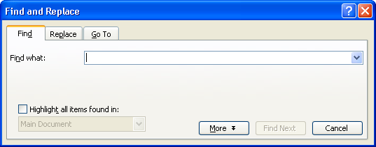
Dialog Boxes:
Use for presenting brief messages.
Use for requesting specific, transient actions.
Use for performing actions that:
Take a short time to complete.
Are not frequently changed.
Command buttons to include:
OK.
Cancel.
Others as necessary.

Slide 33
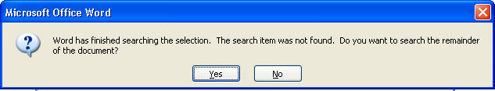
Message Boxes:
Use for displaying a message about a particular situation or condition.
Command buttons to include:
OK.
Cancel.
Help.
Yes and No.
Stop.
Buttons to correct the action that caused the message box to be displayed.
Enable the title bar close box only if the message includes a cancel button.

Slide 34

Palette Windows:
Use to present a set of controls.
Design as resizable.

Slide 35
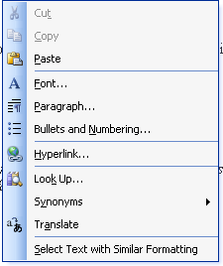
Pop-up Windows:
Use pop-up windows to display:
Additional information.
Textual labels for graphical controls.

